Slide 1
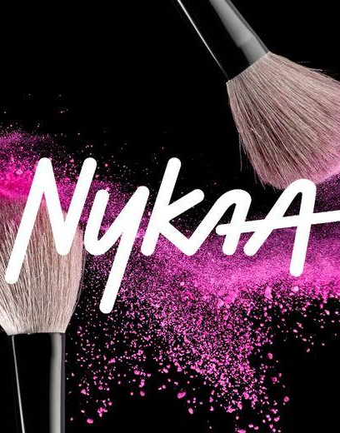

NYKAA ANALYSIS
“Your beauty , our passion”

Slide 2

Overview
Nykaa is a leading Indian e-commerce company specializing in beauty, wellness, and fashion products. Founded in 2012 by Falguni Nayar, a former investment banker, Nykaa has grown from a niche beauty retailer to a comprehensive online and offline lifestyle brand. The name "Nykaa" is derived from the Sanskrit word 'Nayaka', meaning "one in the spotlight," reflecting the company’s mission to empower individuals by enhancing their confidence and self-expression.
Business Model
Vision & Mission
Product categories
Omnichannel Presence
Digital and tech driven platforms
IPO & financial growth
Market position

Slide 3


BUSINESS
MODEL
Nykaa business model operates on the basis of hybrid business model that includes elements :
  Inventory - led (B2C) model
  Marketplace (B2B2C)model
  private label retail
  Omnichannel distribution
  Content -to- commerce
  Advertisement based monetization

Slide 4


STRENGHT
  Strong brand trust and loyal customer base .
  Omnichannel presence (Online +Offline stores ).
  Wide product portfolio +own private labels
  Tech driven personalization and Influencer marketing .
SWOT
WEAKNESS
  Premium pricing perception .
  Profitability concerns (high marketing costs)
  Limited presence in tier-3 and rural markets
OPPURTUNITIES
  Expansion in men’s grooming and fashion
  Growth in tier-2/3 India
  International expansion
  Increasing digital adoption
What is meant by SWOT
THREATS
  Intense competition (Amazon, Flipkart,Purple, Myntra)
  Regulatory hurdles (data privacy, taxation)
  Margin pressures due to discount wars .

Slide 5




MARKET POSITION
What is the Market position and growth of Nykaa
Growth
Market leaderships & Share
  Revenue rose 24% YoY to ₹2,062 crore | PAT surged 110% YoY to ₹19 crore .
  EBITDA grew 43% YoY, with margins expanding to 6.5% from 5.6% .
Nykaa controls approximately 30% of the beauty vertical in India, making it the largest beauty retailer network in the country
Growth(FY 2024-25)
Market leaderships & Share
  Annual revenue: ₹7,950 crore (up 24% YoY)
  GMV: ₹15,604 crore (+25% YoY);
  Net profit: ₹72 crore (+81% YoY);
  EBITDA margin held at ~6%
In FY24, its total beauty GMV reached ₹12,400 crore, with beauty accounting for 73% of Nykaa’s overall GMV .

Slide 6
Competitors of Nykaa
What are the top 3 competitors of nykaa
Purple
Tira
My Glamm
  Budget-friendly, loyalty program, strong UX tech
  Threatens Nykaa’s luxury/premium dominance
  Competes in D2C, community-driven beauty segment
  Strong low-mid segment challenger
  Meanwhile giants like Amazon, Flipkart, Sephora, and Myntra further elevate the competitive landscape.

Slide 7
Customer analysis on social media
Positive about Nykaa
Extensive range, great offers, reliable service for many users
Negative about Nykaa
Concerns over fake reviews, poor customer support, delivery issues, rude responses, occasional counterfeit products
Can a analysis be only positive
Neutral Comments abouts Nykaa
Observations on pricing transparency and app feature changes

Slide 8

  ₹7,950 crore (₹79.5 billion), a 24 % increase over the prior year (~₹6,386 crore in FY24)
What is the revenue of the Nykaa

Slide 9



TEENAGERS AND GEN Z
  They often start with affordable makeup, skincare, and trending brands.
  Active on social media, influenced by beauty influencers and reels/shorts.
Consumer
Segments
MEN ( GROWING SEGMENT)
Influenced by influencers, grooming trends, fitness culture.
Who uses Nykaa products
BEAUTY ENTHUSIASTS & PROFESSIONALS
Primary Users – Women (Age 18–45)
Makeup artists, salon owners, YouTubers, and content creators.

Slide 10
Cost Structure FY 2024-2025
Fixed cost represents the expenses which are regulary happening and fixed .
Variable represents the expenses where the expenses will happen based on the situations or scenarios
Fixed Costs
Employee Salaries and benefits | Rs.565 cr
Tech platform & Admin (SG& A) | Rs.400cr
Variable Costs
Mareketing&Adv,COGS,Fulfillment(logistics/warehousing) | Rs.5,940cr
Total Expenses | Rs.6.905cr

Slide 11
Areas to improve in future
What are the areas does Nykaa need to improve further in future
🔒 Trust & Quality | Verified reviews, product transparency, responsive service
🚚 Delivery & Support | Fast shipping, same-day options, easy returns
🧬 Personalization | AI/AR tools for custom routines, virtual try-ons
🛒 Omnichannel | Expand physical stores with digital integration
🧔 New Markets | Focus on men, Tier 2/3 cities, regional languages
📽️ Content Strategy | Build influencer community, reward honest video content
🧴 Private Label | Launch new clean, functional, or Ayurvedic in-house brands
📈 Smart Analytics | Predict customer needs, automate suggestions

Slide 12



Nykaa is good in
How Nykaa is good in digital marketing , social media ads and branded partnerships
DIRECT MARKETING
  Blends content and commerce
  Builds trust with influencers
  Uses data for personalization
  Optimizes for mobile and SEO
  Engages customers across multiple platforms seamlessly
SOCIAL MEDIA
AND ADS
BRANDED PARTNERSHIPS
Nykaa's ads feel relatable, stylish, and well-targeted
Nykaa acts as both a marketplace and a strategic brand partner, offering visibility, sales channels, and marketing strength.

Slide 13
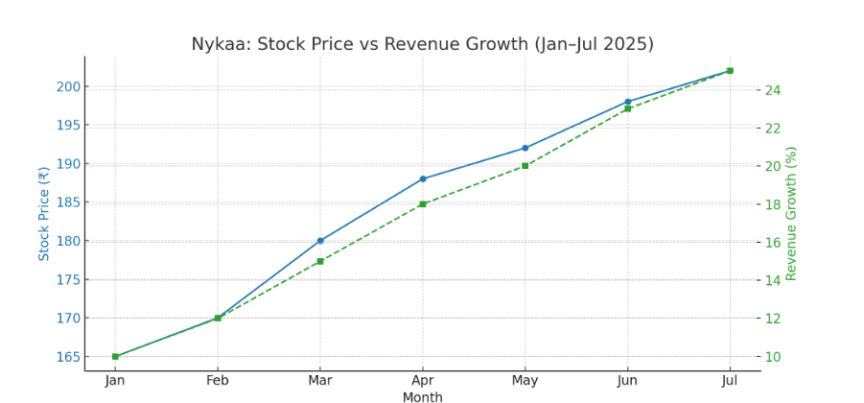
Nykaa Trends
Nykaa's recent market trends from January to July 2025
Blue Line: Nykaa’s stock price rising steadily from ₹165 to ₹202.
Green Dashed Line: Revenue growth percentage increasing from 10% to 25%.

Slide 14
You can connect with
Email
support@nykaa.com
Social Media
@mynykaa
Website
https://www.nykaa.com

Slide 15
My analysis
As a business analyst i have analysed Nykaa ‘s Business model, Swot , Competitors, Marketing growth ,Revenue , cost structure , trends , Consumer Segments ,etc..
Finally, as a business analyst i would like to conclude that Nykaa is a very good and more active brand in the current generation through Influencers , Content creators , Instagram , Websites , offer , Sale etc. Customer whoever paid and buy things from Nykaa , they are expecting the proper products , without any damaged packages and good customer support which is really a reasonable expectations from customers .
It is very much important for the brand to focus more on customer satisfaction areas . Each and every brand will have both positive and negative reviews .
But from a consumer/customer point of view Nykaa need to take the reasonable actions regarding fake reviews , delivery issues , packing , poor customer support
It is the duty of the brands to concentrate more on delivering the quality products rather than promoting a good one to influencers .
Nykaa is a strong brand loyalty in beauty space . Especially Nykaa has a heavy competitors like Purple , Tira, My glamm, Amazon, Flipkart, Myntra , Ajio
So i would recommend Nykaa is good brand in beauty , fashions , makeup , skincare . Every brand has a pros and cons . In the sameway Nykaa also having both pros and cons . From my personal experience Nykaa is a good app where i can get deliveries quickly when compared to others . But i cannot make a insights as a individual point of view .
Best part is Nykaa app is used by all age group of people Gen Z, teenagers, Office women , Men , Above 45+ are also using Nykaa .
When compared to FY 24, Nykaa reached more than 24% increase in revenue .
And they following “ Your Beauty Our passion” correctly

